Slide 1
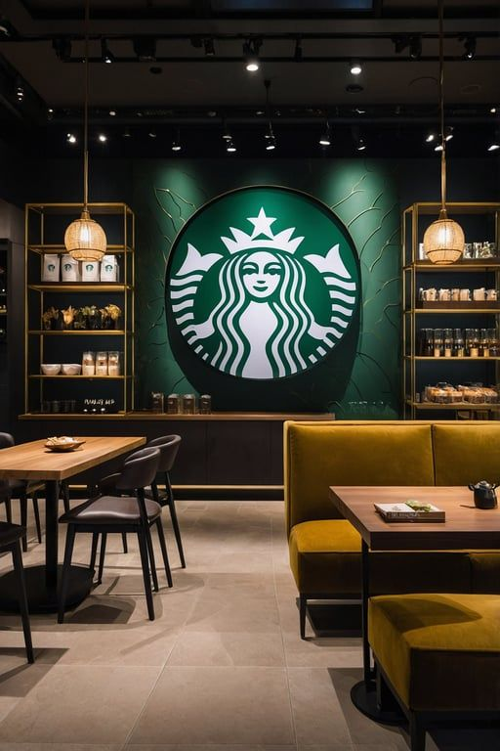
MGTA 495 • Milestone 4 • Final Presentation
BrewFlow AI
AI-Augmented Coffee-Shop Operations
Skills with MCP and RAD
Group 8 - Leia Kawamura / Eesha Jagdhane / Zekai Li

Slide 2




Project Overview
Current Challenge
Our Goal
Baristas rely on memory to recall the full menu, causing:
Inconsistent recommendations
Slower service during peak hours
No real-time inventory awareness
Build a structured AI assistant that:
Guides baristas through a question flow to recommend the right drink
Surfaces inventory insights for managers
Uses GenAI narrowly to explain results
— humans decide
Key User Stories
Business Value
New Barista — AI guides recommendations without full menu knowledge
Store Manager — Flags inventory priorities; GenAI alerts on anomalies
Customer — Gets personalized drink via quick preference questions
Faster, consistent ordering for undecided customers
Reduced reliance on barista memory
Inventory
- aware recommendations per shift
GenAI surfaces insights; all final decisions stay with staff
MGTA 495 • Milestone 3 • Skills Demo
Notes:
"Quick recap for context. The core problem is that baristas rely on memory to guide undecided customers — that leads to inconsistent recommendations and slower service. Our goal was to build a structured AI assistant that walks baristas through a question flow, surfaces inventory priorities for managers, and uses GenAI narrowly to explain results — with humans making all final calls."

Slide 3

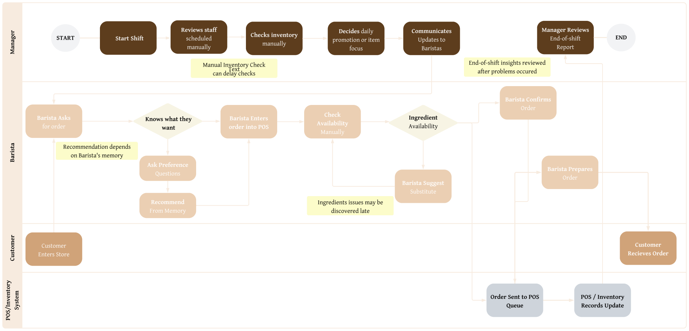
Workflow (Non GenAI)
Notes:
"Here's the overall workflow we designed. It covers the full customer ordering journey on one side, and the manager operations track on the other. Each step maps directly to one of our six skills, which we'll go through next."

Slide 4
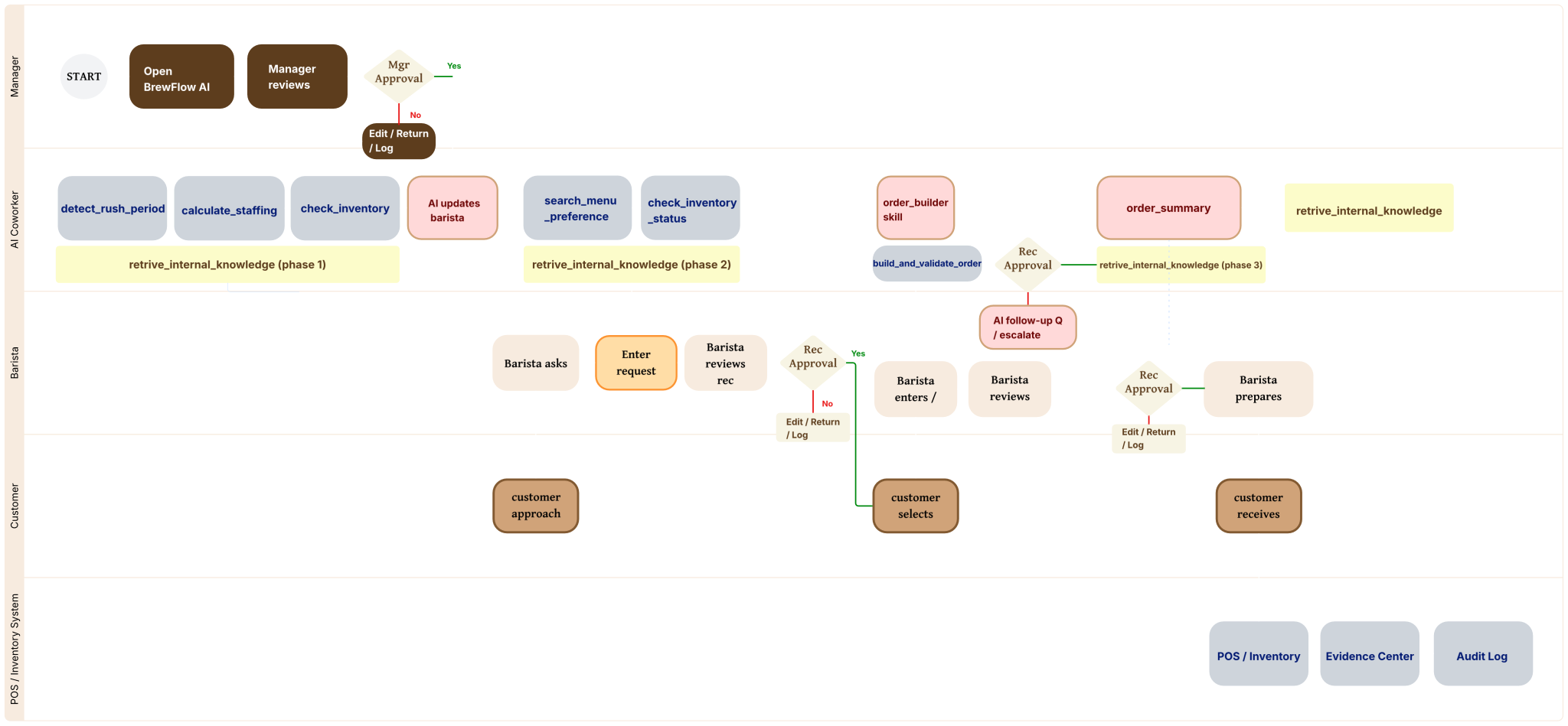
Workflow (GenAI)
Notes:
"Here's the overall workflow we designed. It covers the full customer ordering journey on one side, and the manager operations track on the other. Each step maps directly to one of our six skills, which we'll go through next."

Slide 5




Under the Hood
The pieces that feed the workflow — all rule-based, all predictable
Data — except menu data nine simulated tables
Four rule-based calculators - Automations
Menu: nutrition, caffeine, allergens, customisations
Inventory: daily stock at every store
Order history: about 10,000 hourly counts — the rush signal
Plus staffing, forecasts, promotions and name look-ups
Is it a rush right now?
What’s running low or out of stock?
Are there enough people on shift?
A morning briefing that pulls it together
Six data tools - MCPs
A library of 12 guidelines - RAG
Look up a menu item
Suggest drinks by taste and stock
Check whether ingredients are in stock
Spot a rush, check staffing, and build a full order
Recommendation and allergen guidance
Rush-hour playbook and pre-shift checklist
Substitutions, customisation and quality rules
Same question → same guidance, every time
All data is simulated for class use — no real coffee-chain information is involved other than menu data
BrewFlow AI · Group 8
MGTA 495 · Milestone 04

Slide 6

The Five AI Helpers (Skills)
AI handles the wording — each helper has a clear brief and a moment to step in
1. Product catalogue
Answers menu questions in plain language, and points to where the answer came from.
2. Recommendation
Suggests an in-stock drink with a reason, a backup option, and any caveats worth saying.
3. Order builder
Turns a spoken-style order into clear details — or asks one quick clarifying question.
4. Order summary
Writes the customer’s confirmation and the barista’s prep card, with allergens highlighted.
5. Coordinator
Carries context between the three steps, so each one knows what came before.
BrewFlow AI · Group 8
MGTA 495 · Milestone 04

Slide 7

The UI — Six Screens
A simple web app the whole team can use — a screen for every part of the job
1
Daily Dashboard
2
Manager
3
Barista
An end of day summary view that gives the coffee branch and overview and preparation steps for next day.
Demand, stock, staffing, and the go / no-go call.
Ranked drink ideas, with the reasoning shown.
4
Orders
5
Evidence
6
Review queue
Orders queue and that need to be completed. Recent Activity Log.
Everything behind a result: data used, guidelines, assumptions.
Items waiting for a person to approve, reject or escalate.
On every screen: a running activity log, and a clear banner reminding everyone the data is simulated.
BrewFlow AI · Group 8
MGTA 495 · Milestone 04

Slide 8



How the UI Works
One coordinator runs three steps in order, passing what it learns down the line
1
Manager readiness
2
Drink recommendation
3
Order taking
Checks demand, stock and staffing
Pulls up the right playbook
Gives a clear go / no-go briefing
Flags low stock or short staffing
Barista types the request in plain words
Suggests in-stock drinks that fit
Explains the pick, offers a backup
A barista confirms before the customer
Reads the spoken-style order
Matches the item, checks ingredients
Asks about anything unclear
Sends allergy notes to trained staff
Every run hands the team: a plain-English result, the evidence behind it, anything that needs approval, and a full activity log.
Allergy safeguard: any allergy or dietary wording sends the order to trained staff — automatically, every time, and it can’t be switched off.
BrewFlow AI · Group 8
MGTA 495 · Milestone 04

Slide 9
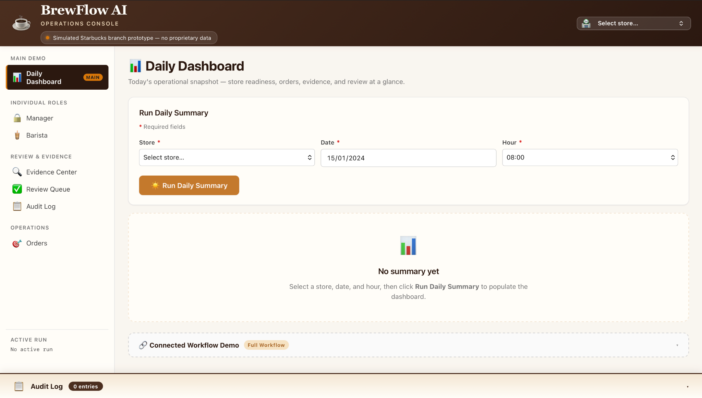
Live Demo
Open milestone 4 directory in terminal and then run uv run python ui/app.py to access live demo
BrewFlow AI · Group 8
MGTA 495 · Milestone 04

Slide 10

Humans Stay in Control
Seven points where a person must approve before the workflow goes on
When | What a person does
Critical stock at open | Manager confirms whether to open the shift
Short staffing | Manager approves cover or calls people in
Before a recommendation reaches a customer | Barista reviews and confirms it ★ must approve
Order details missing | Barista checks with the customer first
Allergy wording detected | Trained staff reviews; escalate if needed ★ must approve
Before prep starts | Barista confirms the summary matches the order
A result looks doubtful | A person reviews the concern before filing
Review is the rule
Review is the normal path, not the exception
Two steps are mandatory — nothing moves until a person signs off
There’s no “skip” button
The activity log can’t be edited after the fact
BrewFlow AI · Group 8
MGTA 495 · Milestone 04

Slide 11


Transparency by Default
A reviewer can always see how a result was reached — nothing is hidden
The evidence
Activity Log
A sanity check
Which data was used, and any fallback
Which guidelines were pulled in
What the calculators reported
Assumptions and warnings, in the open
A simple completeness score
A running, unchangeable record
Each step and when it happened
Who acted — the system or a named staff member
What they decided at that point
Looks right → go ahead
A bit thin → flag for review
Doubtful → send to a person
It reads only the order, the warnings and the review notes — so a guideline’s title can never be mistaken for a real allergy alert.
BrewFlow AI · Group 8
MGTA 495 · Milestone 04

Slide 12


Tested for Failure
95 checks pass on a laptop — and we planned for the ways it could go wrong
What we check | Checks
Data tools | 31
Finding the right guideline | 16
The full workflow | 23
The sanity check | 15
The app screens | 14
All passing | 99
Eight failures we planned for
A drink isn’t recognised → ask the customer to clarify
Stock data is missing for a date → use the most recent figures and say so
An out-of-stock drink gets suggested → it’s filtered out before it’s offered
A staffing gap is ignored in a rush → the sanity check catches the contradiction
An allergy isn’t escalated → the safeguard forces a review, every time
The wrong guideline is pulled → relevance scoring, checked for each one
The evidence is thin → it’s flagged “weak,” not shown as solid
A false allergy alert from a filename → the check now reads only the order itself
99 checks, all passing
BrewFlow AI · Group 8
MGTA 495 · Milestone 04

Slide 13

Impact — Time, Cost & Quality
Before-and-after estimates with honest ranges — educational assumptions only
~60%
100%
85–90%
100%
less manager prep
of orders checked (was ~60%)
drink picks right (was ~70%)
of decisions logged (was ~20%)
Task, per shift | Before | After | Saved
Manager morning readiness | 25–40 min | 8–15 min | ~60–65%
Drink recommendation (per customer) | 1–3 min | 0.5–1.5 min | ~40–50%
Taking and checking an order | 2–4 min | 1–2 min | ~40–50%
Whole shift cycle | 33–72 min | 15–34 min | ~30–55%
These figures come from simulated data and published benchmarks — not real operations, and not meant for business decisions.
BrewFlow AI · Group 8
MGTA 495 · Milestone 04

Slide 14


Built Responsibly
What we stand by — and what we’re honest about
What we stand by
What we’re honest about
All data is simulated, for class use
Drinks are made one at a time, even at peak
Allergy wording always escalates — it can’t be turned off
Human review is the default, not the exception
The evidence is always on show
Nothing leaves the laptop
Predictable everywhere except the final wording
Simulated data only — not for real decisions
The activity log resets when the app restarts
Time savings are estimated, not measured
Dairy-free is inferred from the vegan label (a noted assumption)
No automatic check yet that pulled guidelines are truly on-point
The AI wording step is modelled, not run live in testing
The review queue is one session, one user at a time
BrewFlow AI · Group 8
MGTA 495 · Milestone 04

Slide 15

Thank You
BrewFlow AI — smart help for every shift, with people in charge
Group 8 · Leia Kawamura / Eesha Jagdhane / Zekai Li · MGTA 495 · Milestone 04
All data is simulated for educational purposes only.

